Slide 1
WEEK 2
Dr. Mbira

Slide 2
In the 2nd week, implantation is complete. The trophoblast divides properly into 2 layers, the syncytiotrophoblast and cytotrophoblast.
Also there is apoptosis of the endometrial cells around the area of the invading trophoblast cells which allows the embryo to embed itself into the substance of the endometrium.
Endometrial cells also accumulate glycogen and lipids so that when they undergo programmed cell death(apoptosis), their cytoplasm provides nutrition for the embryo by being engulfed by the trophoblast cells.
The embryo embeds itself deep enough in the endometrium to be actually covered by the endometrial epithelium.
It will then protrude out of this epithelium as the pregnancy advances and the embryo becomes bigger.

Slide 3
Implantation will complete by around the 10th day and the syncytiotrophoblast will begin to produce human Chorionic Gonadotropin(hCG) hormone which will keep the corpus luteum of pregnancy active in the production of progesterone.
Progesterone will in turn maintain the endometrium in the thickened, succulent, well vascularized state that is ideal for implantation and nourishment of the embryo.
The concentrations of hCG will keep increasing exponentially as the embryo grows so that its concentration which will enter maternal circulation can provide a fairly accurate measure of the age of the embryo.
It takes about 2 weeks for enough hCG to enter maternal circulation to be detected by lab tests; the basis of a pregnancy test.

Slide 4
By the 9th day, the syncytiotrophoblast develops large spaces within it called lacunae. This then makes this stage of the trophoblast development to be termed the lacunar stage.
The invading syncytiotrophoblast will encounter maternal capillaries and subsequently erode their walls causing them to bleed into these lacunae.
With more capillaries having their blood in these syncytiotrophoblast lacunae, then there will be circulation of maternal blood in the trophoblast thus establishing uteroplacental circulation.
Some of the bleeding into the lacunae may spill into the uterine lumen and be passed out to mimic a normal menstrual flow.

Slide 5
The endometrium during implantation especially at the implantation site will undergo some changes called decidua reaction:
Cells become polyhedral and filled with glycogen and lipids.
The surrounding tissue becomes edematous and filled with extravasated fluid and proteins.
These changes will eventually occur throughout the whole endometrium.
The decidua reaction helps also to shield the embryo from the maternal antibodies.
By day 13, cytotrophoblast develops finger-like projections(villi) which project into and are thus surrounded by syncytiotrophoblast and are known as primary villi.

Slide 6
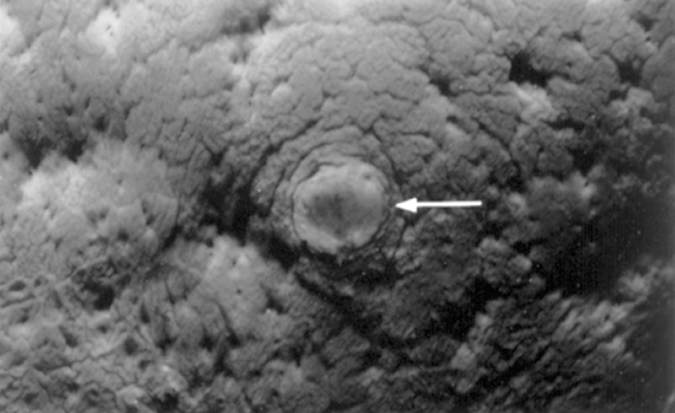
By end of the 2nd week, implantation is complete and the initial defect in the endometrium where the embryo has “burrowed” in while at first covered by a clot or fibrin coagulum now becomes covered by newly regenerated endometrial epithelium.
The only evidence at this stage is a slight bulge as seen from the lumen of the uterus.

Slide 7
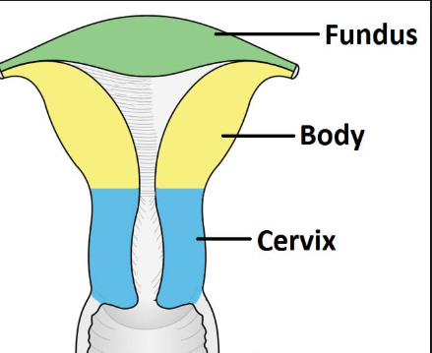
Implantation normally occurs in the upper part of the body of the uterus more commonly posteriorly but sometimes anteriorly.

Slide 8
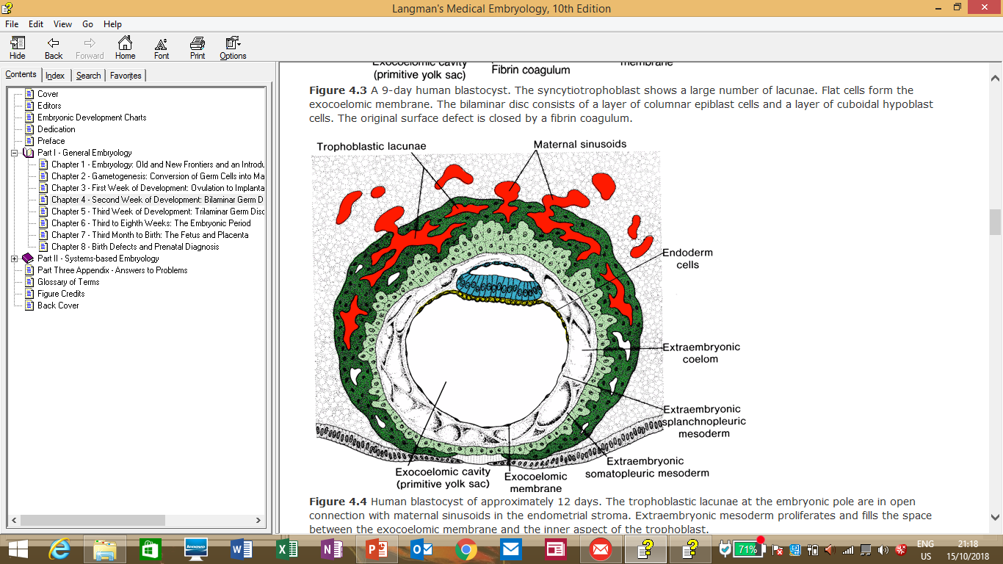
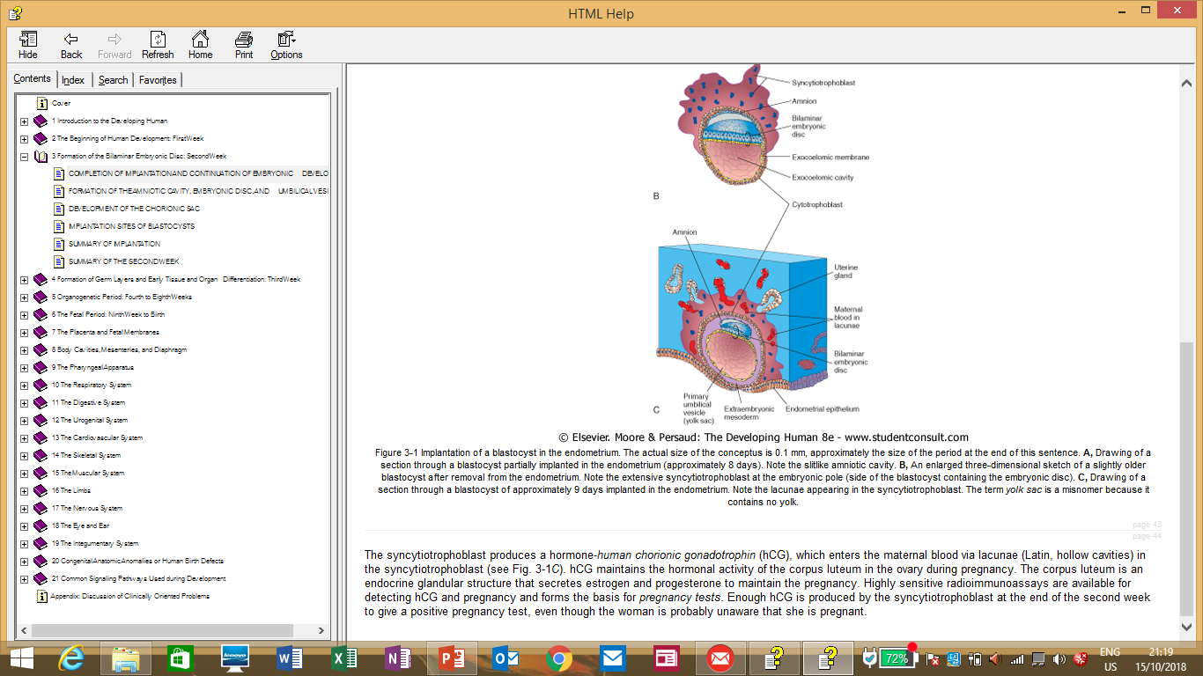

Slide 9
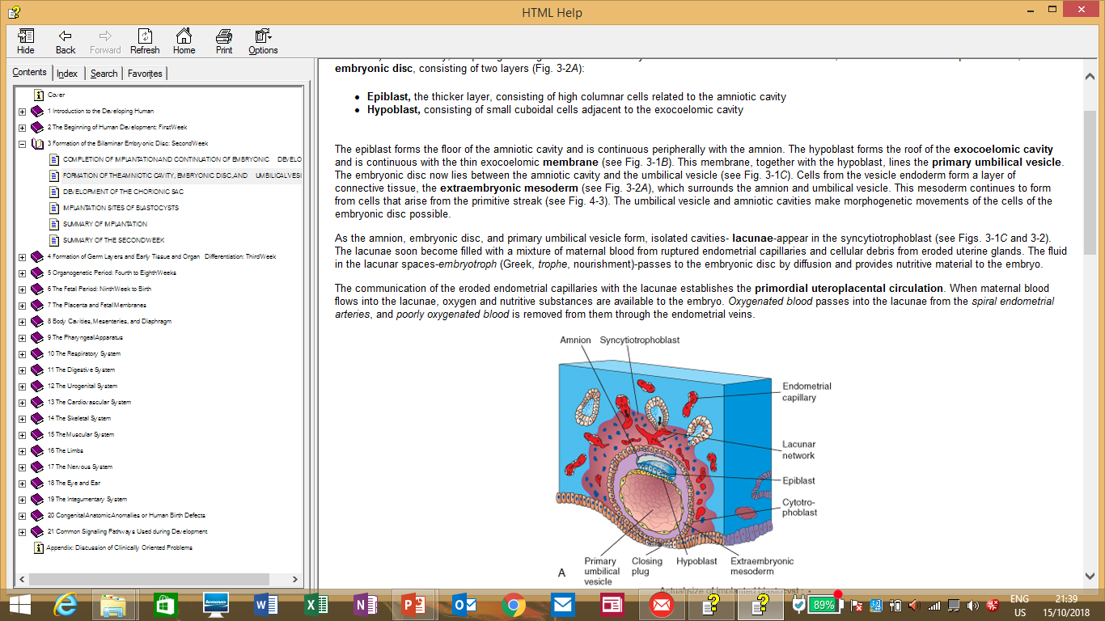
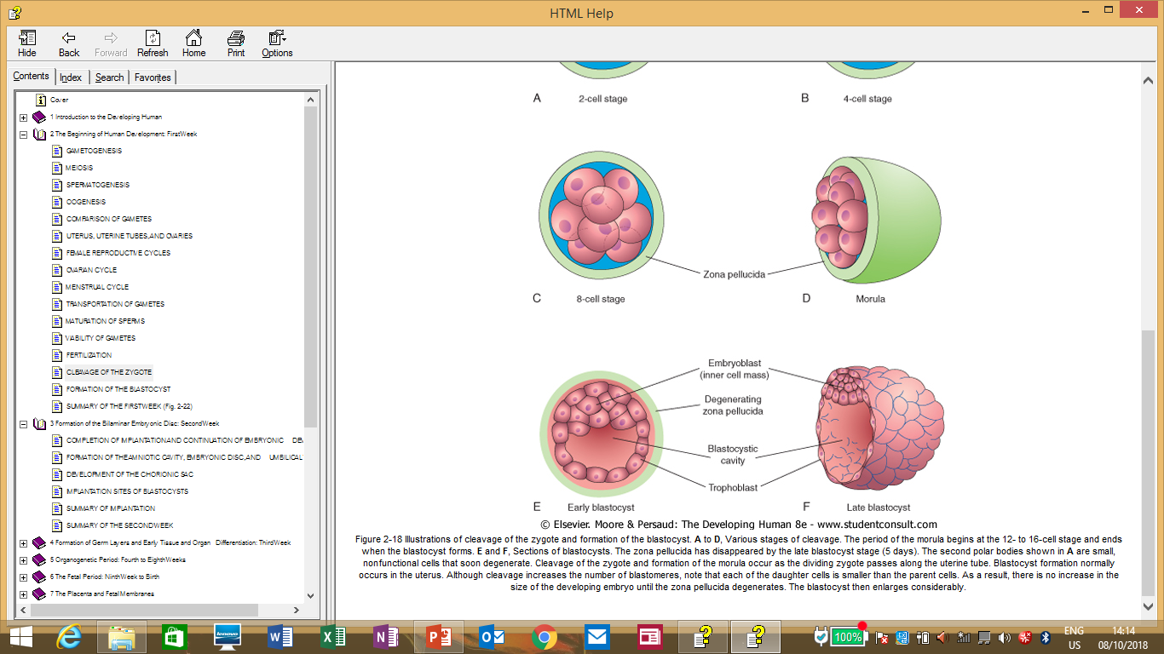
On day 8, the trophoblast is already dividing into 2 layers, also the inner cell mass(embryoblast) divides into 2 layers – epiblast and hypoblast, with a cavity appearing in the epiblast.

Slide 10
The space/cavity appearing in the epiblast will eventually become the amniotic cavity. Some cells of the epiblast will surround this cavity and become cells of the amnion or amnioblasts.
The embryoblast meanwhile will now be in 2 layers i.e the epiblast (adjacent to the amniotic cavity) and hypoblast (adjacent to the blastocystic cavity).
This 2 layers (epiblast and hypoblast) will form a flattened mass of cells with the layer of epiblast being thicker and will resemble a disc. The 2 layered nature of this disc and the fact that it is made up of germ cells will lead to it being called the bilaminar germ disc or embryonic disc.
The blastocystic cavity now becomes the primitive yolk sac/primary umbilical vesicle/exocoelomic cavity and is lined by a thin layer of cells derived from the hypoblast called the Heuser membrane or exocoelomic membrane.

Slide 11
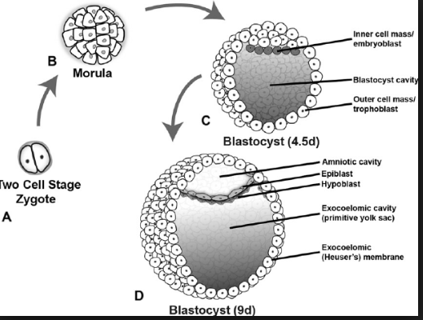

Slide 12
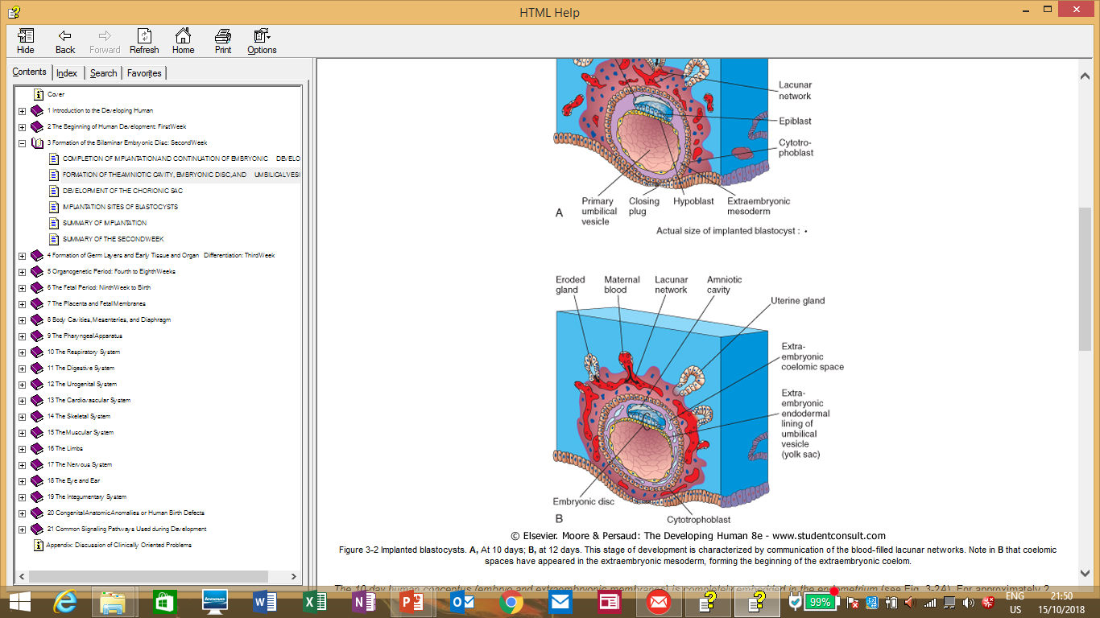
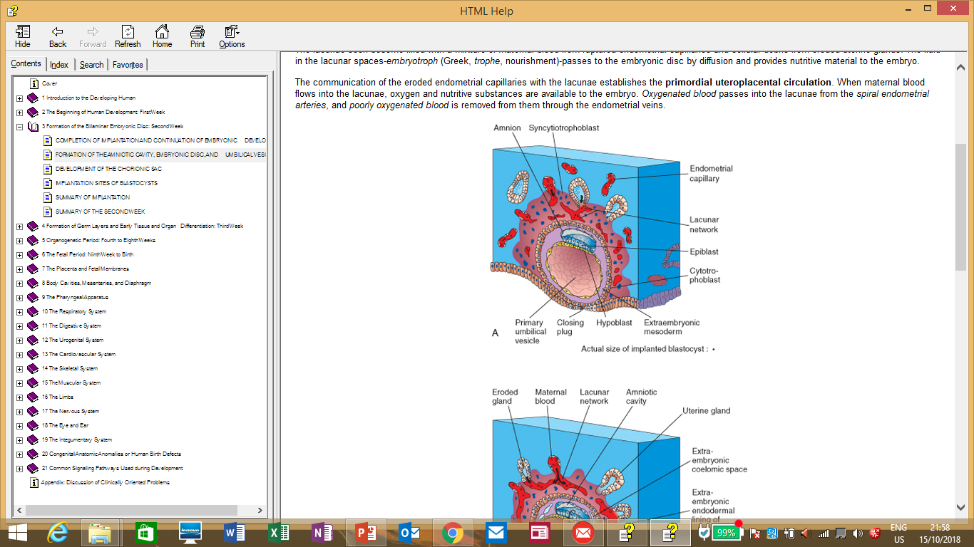

Slide 13
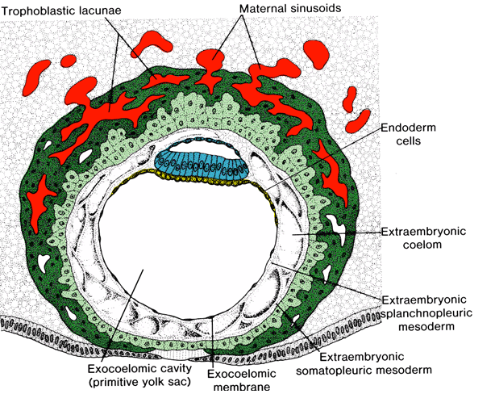
Between day 11 and 12, there is a
new space that forms between the
exocoelomic cavity/yolk sac and
the cytotrophoblast layer of
cells and this space becomes
populated by new cells derived
from the yolk sac. This space becomes
the extraembryonic mesoderm.
This mesoderm then will surround
the whole embryo.

Slide 14
A cavity will then form in this extraembryonic mesoderm, dividing the cells in it into 2 layers. The cavity is called the extraembryonic coelom or chorionic cavity.
The layer of mesodermal cells surrounding the embryo i.e the amnion and yolk sac is called the extraembryonic splanchnic mesoderm while that lining the inside of the cytotrophoblast is called the extraembryonic somatic mesoderm.
The extraembryonic coelom/chorionic cavity will surround the embryo except at a small area where a mass of cells will connect the embryo to the trophoblast called the connecting stalk.

Slide 15
The hypoblast will produce new cells which will form a newer smaller cavity within the primitive yolk sac/primary umbilical vesicle/exocoelomic cavity to form the secondary/definitive yolk sac.
As the primitive yolk sac disappears, some of its remnants may be seen as exocoelomic cysts.
At this stage around day 14, the embryo is made up of 2 layers of cells; epiblast and hypoblast adjacent to 2 cavities; amniotic cavity and definitive yolk sac respectively all suspended in a space ;the extraembryonic coelom/chorionic cavity and connected to the trophoblast layers via a connecting stalk.

Slide 16
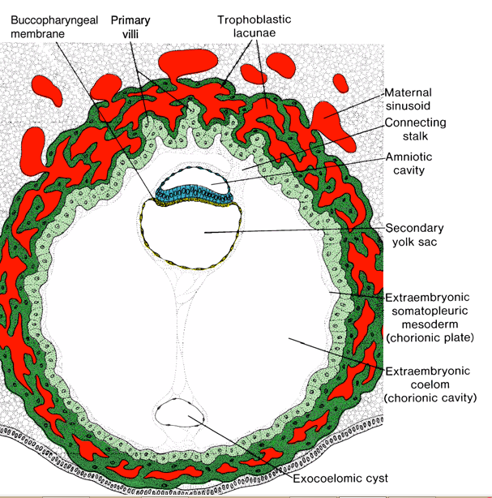

Slide 17
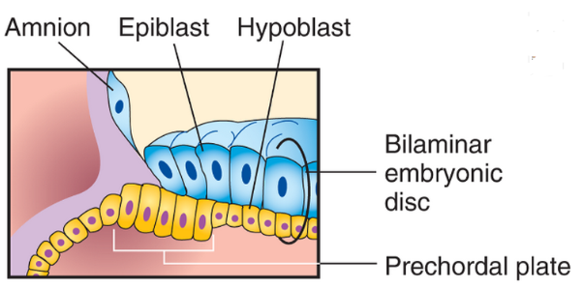
The extraembryonic somatic mesoderm together with the 2 layers of trophoblast form the chorion.
The chorion encloses the chorionic cavity within which is the developing embryo connected to the chorion via a connecting stalk.
The hypoblast layer of cells while for the most part is flattened, it will form at around the 14th day a thickened circular area called the prechordal plate.

Slide 18
*Week of 2’s
*Ectopic pregnancy
*Spotting

